Slide 1
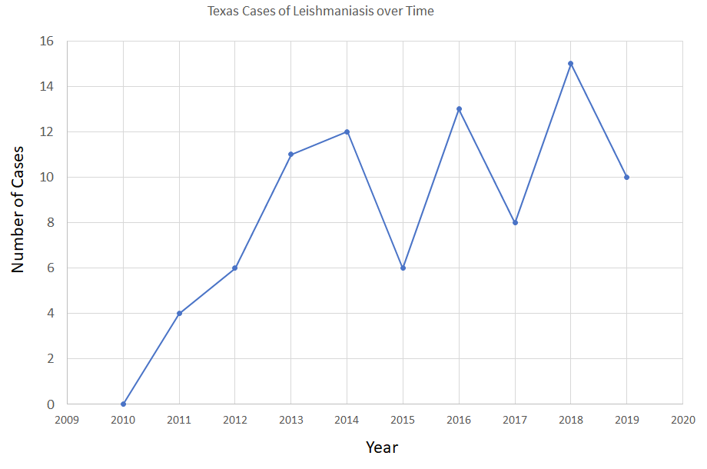
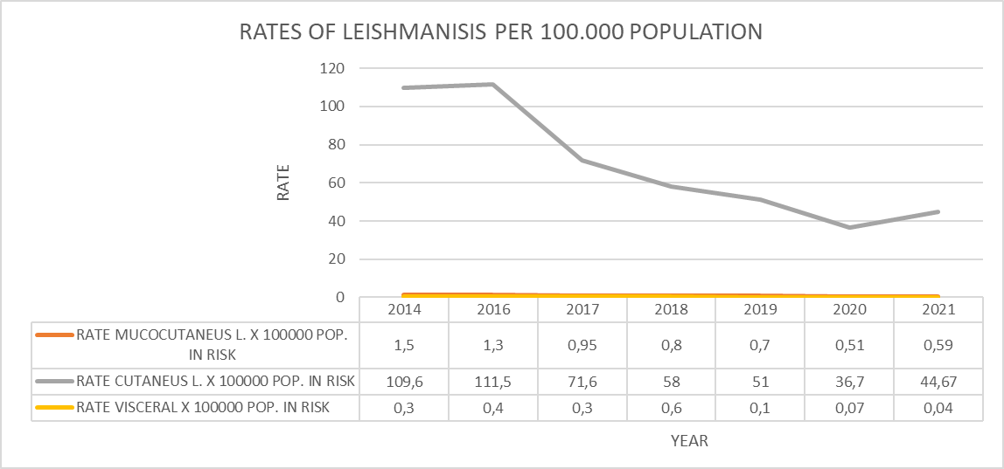
PROPOSAL TO ADDRESS THE INCIDENCE OF LEISHMANIA IN COLOMBIA AND TEXAS
Catherine Vrentas, Chellise Kemis, Anderson Lucena, María Camila Oyuela and María Paula Herrera
INTRODUCTION
Leishmaniasis is a parasitic disease caused by protozoan parasites transmitted through the bites of sandflies. It is considered as a neglected tropical disease by the CDC (1). There are three types of the disease: mucocutaneous, which is characterized by extensive destruction of the nasal and oral mucous membranes; cutaneous, the symptoms including skin lesions and ulcers, is the most common form worldwide; and the visceral which is the most severe form with symptoms including fever, weight loss, hepatosplenomegaly, and anemia.
There are approximately 70 animal species serving as parasite reservoirs, meanwhile humans are not required for the life cycle of most species and it is difficult to eliminate all potential reservoirs of disease. This parasitism is not homogeneously distributed in the nature, rather is localized in places where there are key elements such as vectors and the host. (2)
Most of the cases of Leishmaniasis in Colombia are associated with military personnel, farmers, housewives and children living in rural areas.
JUSTIFICATION
Leishmaniasis is increasing range due to climate changes, rural to urban migration, displacement and travel. Other factors associated to the increase of the rates of Leishmania, are the poverty and malnutrition, which weakens the immune system and influences vector competence. (2)
It is an endemic disease in Colombia, however it is not federally reportable in United States, though reportable in Texas since 2007 because of the difficulties identifying the disease. (3)
Since 2010, cases of Leishmaniasis in Texas have been reported with fluctuating changes, but always towards the increase. The last report was in 2019 with 10 cases. The incidence of Leishmaniasis in Texas has been reported in the last 10 years, as 0, therefore the low incidence of this disease is evident compared to Colombia, where there is an incidence with a tendency to decrease, since 2014 with 109.6 vs 2021 with 44.67 per 100,000 inhabitants.
Source: Prepared from data compiled from the Texas Public Health Department (2022).
Source: own elaboration with data from SIVIGILA (Colombia). Event reports of Leishmaniasis.
PURPOSE
Achieve a progressive and sustained reduction in the number of cases of Leishmaniasis.
TARGET POPULATION
People living in rural areas in Colombia and Texas. Specially in Colombia, in areas with tropical dry forest and endemic regions for leishmaniasis.
OBJECTIVE
1. Increase awareness of changes in disease ranges.
2. Develop system for surveillance, including areas where incidence is low but increasing; through insect samples, animal samples, human samples.
3. Increase awareness among medical professionals of the disease in these areas; also use effective survey questions at primary physicians
4. Invest in One Health approach to the disease; coordinate ecological research, veterinary, human health.
ETHICAL ASPECTS
Ethical principles must be taken into account for the development of health promotion and disease prevention activities, where non-maleficence, beneficence, autonomy and justice prevail. Also the informed consent has to be guaranteed in the participation of the purpose, and the disclosure of information in a timely, accurate and quality manner.
EXPECTED RESULTS
Increased testing is expected to increase apparent rates of disease initially, but will better define true disease burden.
One Health control measures are expected to reduce disease rates and disease spread by targeting human, animal, and environment.
One Health and climate change control and mitigation efforts are expected to reduce not only disease burden from this disease but also disease burden from other vector-borne and emerging threats.
BIBLIOGRAPHY
(1) CDC - Leishmaniasis - Epidemiology & Risk Factors. Accessed May 2, 2022. https://www.cdc.gov/parasites/leishmaniasis/epi.html
(2) Burza, S. (2018). Leishmaniasis. The Lancet, 392(10151), 951–970.
(3) McIlwee BE, Weis SE, Hosler GA. Incidence of Endemic Human Cutaneous Leishmaniasis in the United States. JAMA Dermatol. 2018;154(9):1032–1039. doi:10.1001/jamadermatol.2018.2133
WWW.OIISP.ORG

