Slide 1
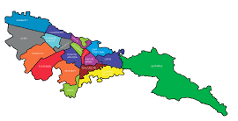
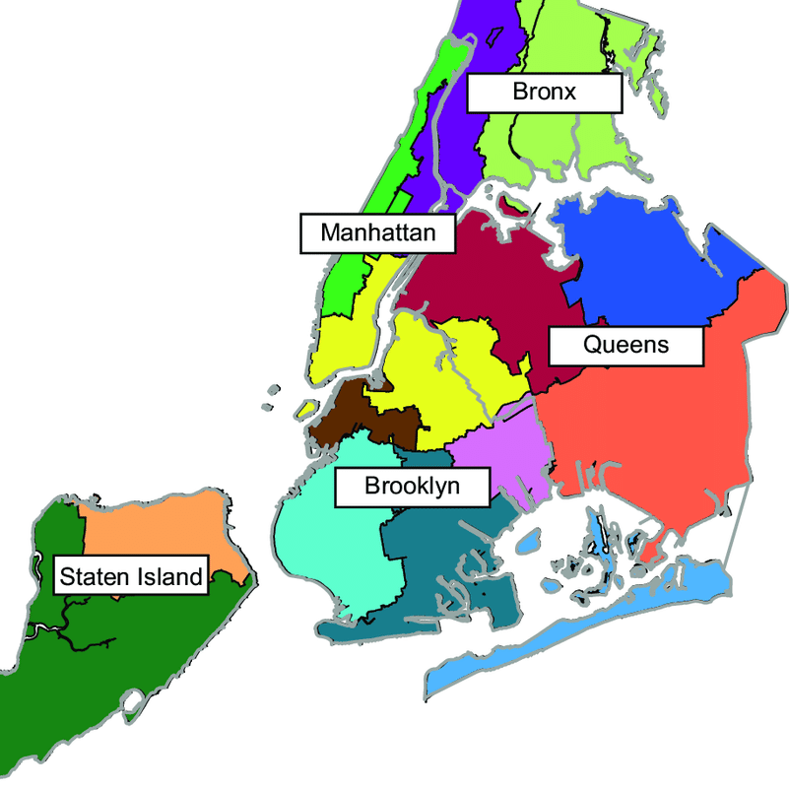
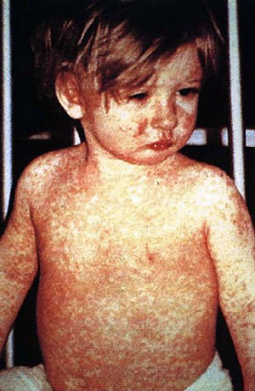
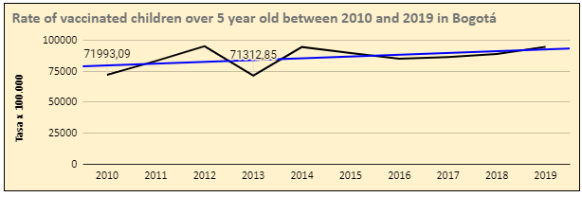
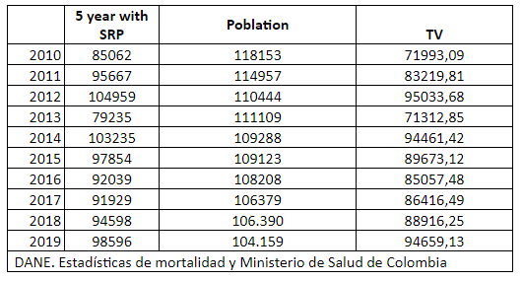
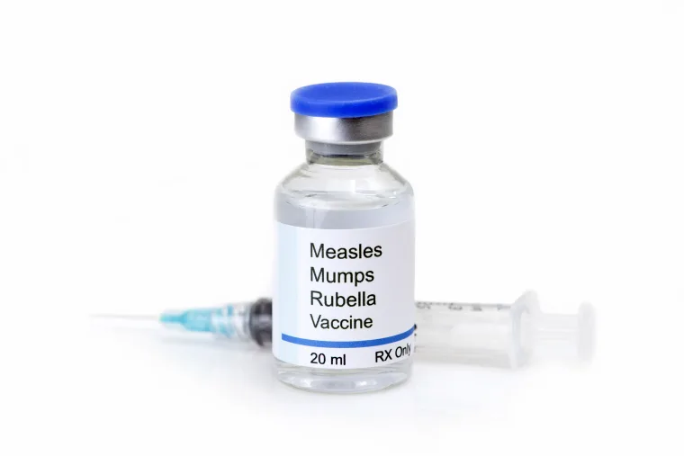
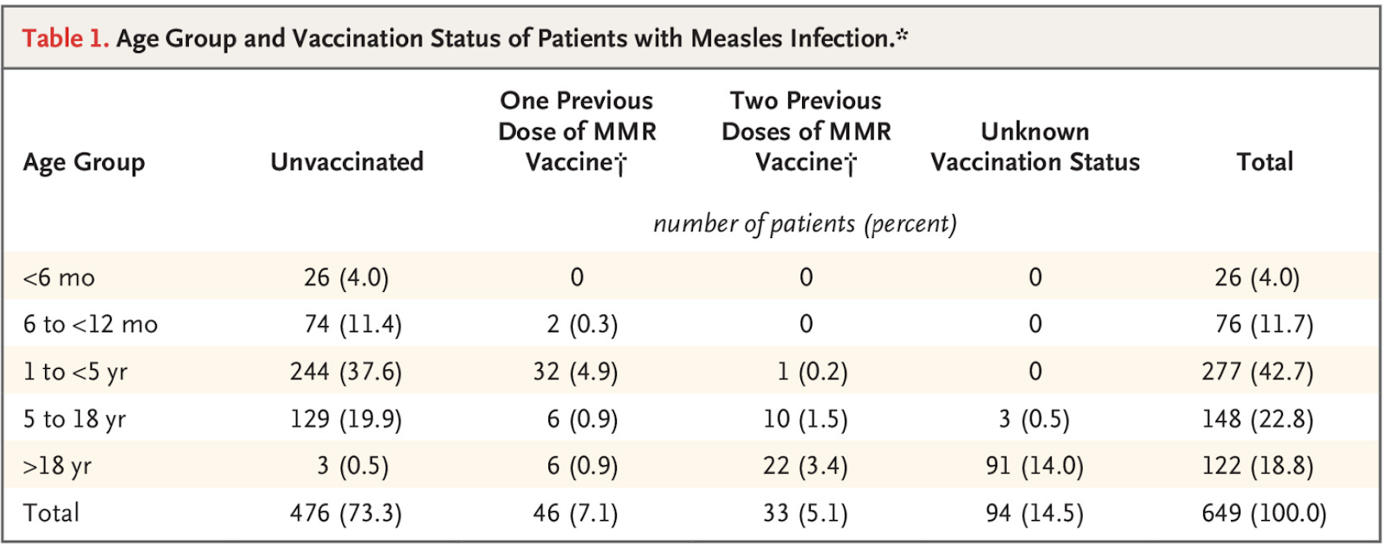
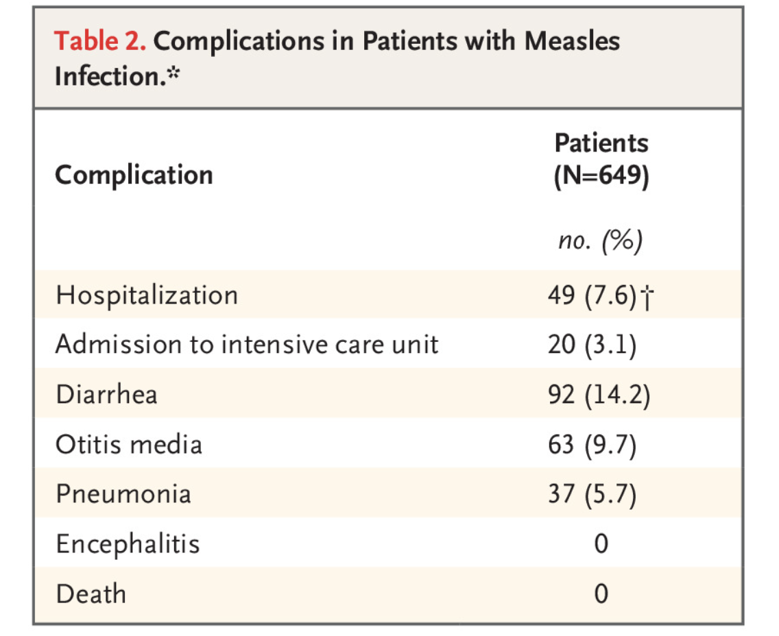
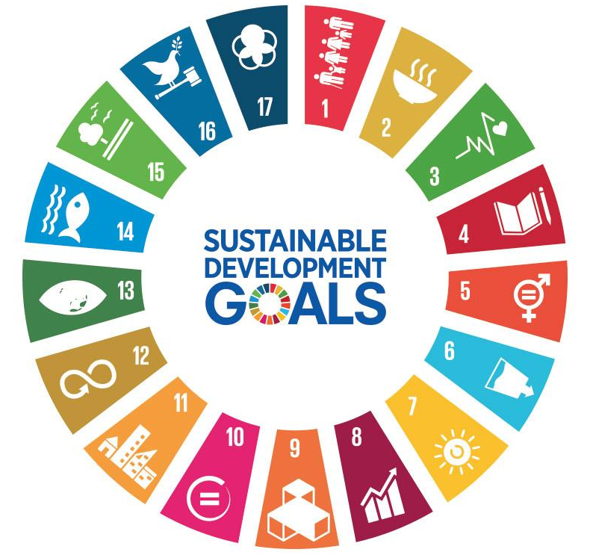
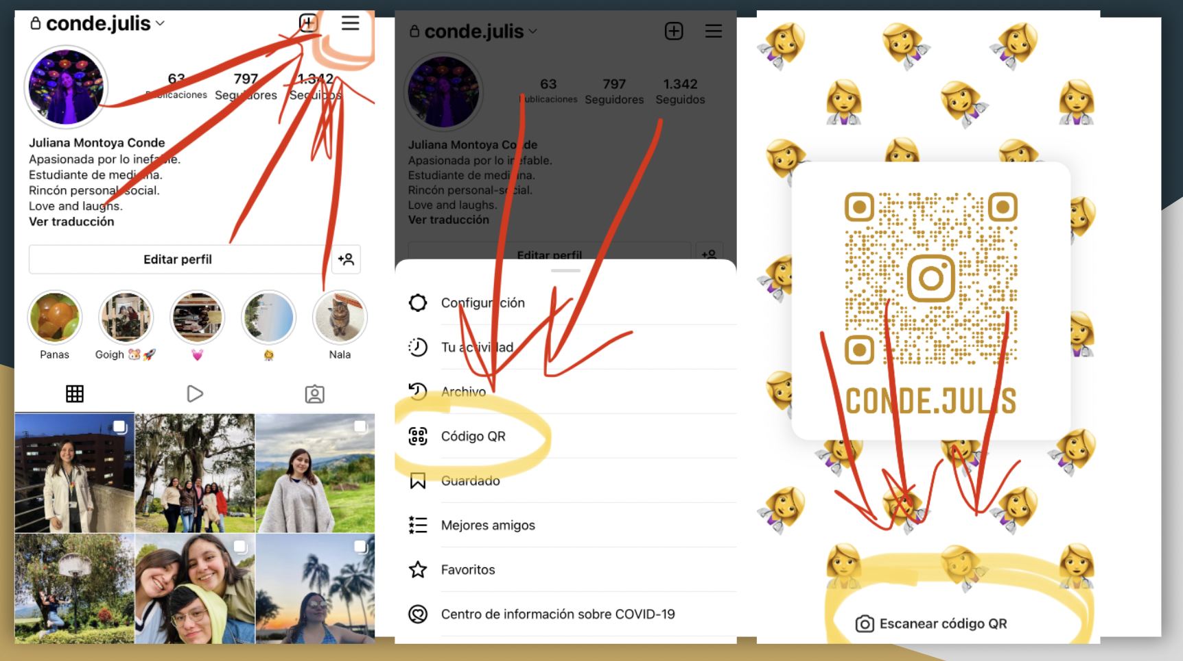
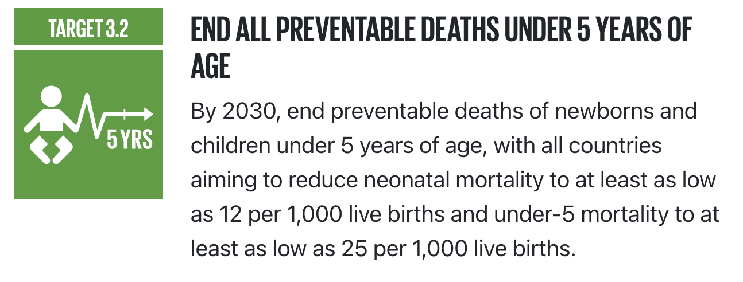
Increasing Measles, Mumps, and Rubella (MMR) Vaccination in Children in Bogota, Colombia & New York City, United States
Maria Camila Payan Rodriguez, Genevieve Richards, Sara Marulanda Muñoz, Laura Nicole Largo Aristizabal, Juliana Andrea Montoya Conde
Population 7.3 million
Urban
Purpose
Population: 8.2 million
Urban
To compare Measles outbreaks and vaccination rates within children 5 years and younger in Bogota, Colombia and New York City, United States using U.N. Sustainable Development Goals and to develop a proposal to improve vaccination rates.
What is Measles?
It is a highly contagious viral illness. It usually presents as a maculopapular rash with cough, coryza, conjunctivitis, and Koplik spots. The virus is highly contagious because it can remain infectious on a fomite for up to 2 hours. 9/10 people who are in close contact with measles will get the virus if not vaccinated with MMR. 30% of Measles cases develop complications. The disease is preventable with the MMR vaccine which is 97% effective, and 2 doses are recommended to all children that are immunocompetent per CDC and PAI.
In the last 5 years, measles cases have risen in Bogota and NYC due to both cities being popular ports of immigration and travel.
Target Population
Children
1- 5 years
Bogotá vs New York
https://www.shutterstock.com/es/image-vector/kids-icon-vector-illustration-1170447067
https://historiasdenuevayork.es/2011/07/06/bandera-de-la-ciudad-de-nueva-york /
Data: Bogota vs. New York City
https://en.wikipedia.org/wiki/Measles
Prevention
https://saludata.saludcapital.gov.co/osb/index.php/datos-de-salud/enfermedades-trasmisibles/vacunacion/
VACCINE → MMR Live attenuated
In 2013 and 2014 New York City experienced an outbreak, 58 and 25 cases respectively
2015-2018 cases remained low.
97% effective
649 confirmed cases
Median Age: 3 years old
Unvaccinated 85.8%
PAI: 1 year (1st Dose) 5 years (2nd Dose)
CDC: 12-15 months (1st Does) 5-6 years (2nd Dose
Justification
It is necessary to develop projects that contribute to promoting the use of the vaccine, to improve the protection and immunity of children.
Zucker, J. R., et al. (2020). Consequences of Undervaccination — Measles Outbreak, New York City, 2018–2019. New England Journal of Medicine, 382(11), 1009–1017. https://doi.org/10.1056/nejmoa1912514
Anecdotal reports suggested that parents were holding “measles parties” to deliberately expose their unimmunized children to measles.
U.N. Sustainable Development Goal
#Envision2030 Goal 3: Good Health and Well-being
Proposed Intervention
To educate the public through social media platforms and combat false information.
Indicators:
Child mortality rate (SDG)
MMR Vaccination
References
Center for Disease Control and Prevention. (2022, June). Measles Cases and Outbreaks. https://www.cdc.gov/measles/cases-outbreaks.html
DANE. Proyecciones de población. Disponible en: http://www.dane.gov.co/index.php/estadisticas-por-tema/demografia-y-poblacion/proyecciones-de-poblacion
Buchholz, K. (2020, November 12). Measles: Deadly Disease Makes a Comeback. Statista Infographics. https://www.statista.com/chart/20222/annual-global-deaths-of-measles/
WWW.OIISP.ORG

